Slide 1
Capstone Engagement
Assessment, Analysis, and Hardening of a Vulnerable System

Slide 2
Table of Contents
This document contains the following sections:
01
Network Topology
02
Red Team: Security Assessment
03
Blue Team: Log Analysis and Attack Characterization
Hardening: Proposed Alarms and Mitigation Strategies
04

Slide 3
Network Topology
‹#›

Slide 4
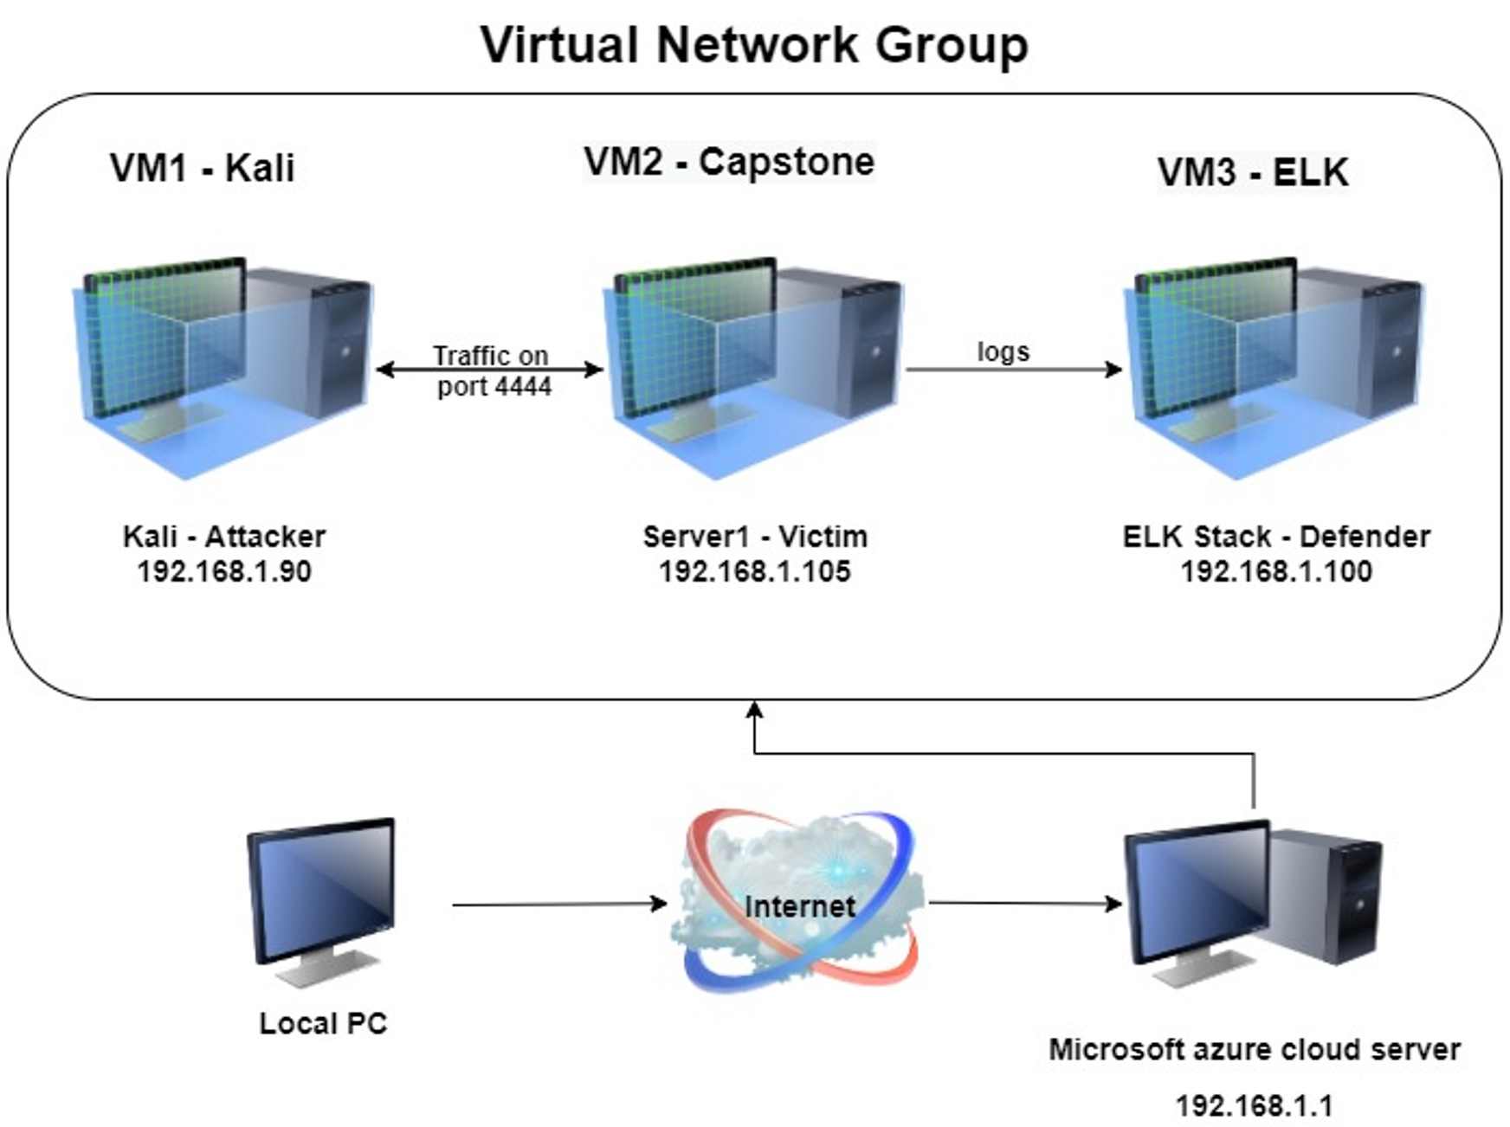
Network Topology
Network
Address Range: 192.168.1.1/24
Netmask: 255.255.255.0
Gateway: 192.168.1.1
Machines
IPv4: 192.168.1.90
OS: Kali linux (Attacker)
Hostname: kali
IPv4: 192.168.1.100
OS: Linux (Defender)
Hostname: ELK
IPv4: 192.168.1.105
OS: Linux (Victim)
Hostname: Capstone
IPv4: 192.168.1.1
OS: Windows 10
Hostname:ML-RefVM-684427

Slide 5

Red Team
Security Assessment
‹#›

Slide 6
Recon: Describing the Target
Nmap identified the following hosts on the network:
Hostname | IP Address | Role on Network
Kali | 192.168.1.90 | An “attacker” machine was used to replicate an offensive attack on a vulnerable machine. Its main role was to attack the victim.
ELK | 192.168.1.100 | This machine was used to analyze the network traffic caused by the “attacker”. Its main role was to defend the victim.
Capstone (server1) | 192.168.1.105 | This machine was used to replicate a vulnerable web-server within the virtual network.

Slide 7
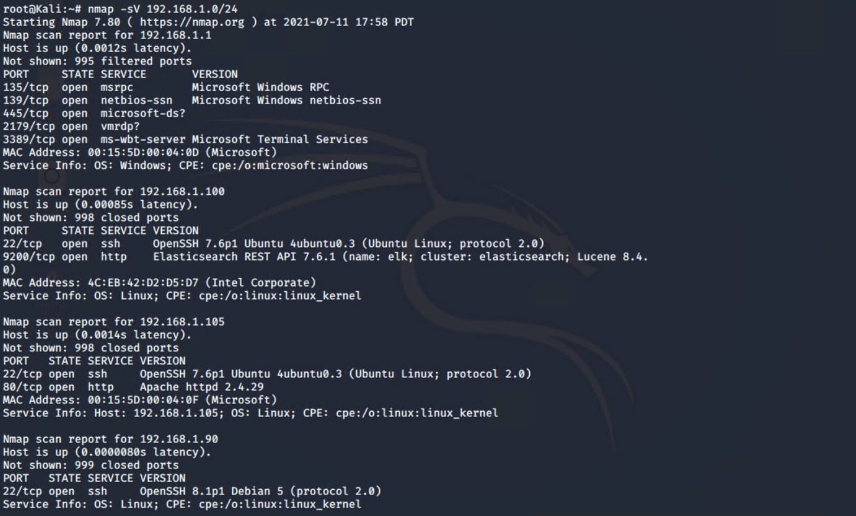
NMAP: Scan results

Slide 8
Vulnerability Assessment
The assessment uncovered the following critical vulnerabilities in the target:
Vulnerability | Description | Impact
Weak passwords / Brute Force vulnerability | The client passwords did not implement any complexity and were less than 8 characters | Uncomplex and weak passwords can be subject to brute-force attacks which are often successful
Data exposure in web interface | Company files were openly available including a user account and its corresponding MD5 hash | A password hash can be easily cracked using a variety of open source tools which can be used to access sensitive data
Poor security restrictions/controls (webdav) | The client’s webdav server did not have any firewalls implemented and allowed any file to be uploaded on the webserver from any device. | Hackers have the tendency to implement malicious scripts to gain full control using reverse shells. Additionally, lateral movement will lead to data exfiltration

Slide 9
Exploitation: Weak Passwords
01
02
03
Tools & Processes
A series of nmap and dirb scans lead to the discovery of a web-server hosted on the capstone machine. The red-team found a secret folder that was meant for “Ashton’s eyes only” so we used Hydra to brute force the password with a well known word list.
Achievements The red-team was successful in bruteforcing the password to the secret folder - ashton:leopoldo. This lead to another file that contained an MD5 hash to the company’s webdav server.
hydra -l ashton -P /usr/share/wordlists/rockyou.txt -s 80 -f -vV 192.168.1.105 http-get /company_folders/secret_folder
Please see next slide for screenshots

Slide 10
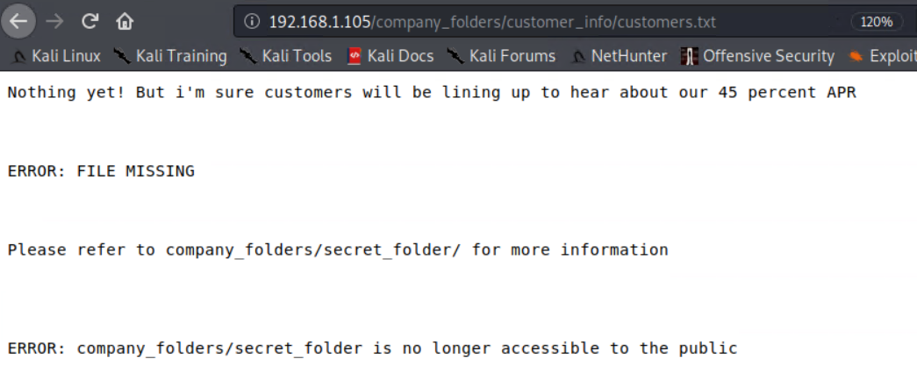
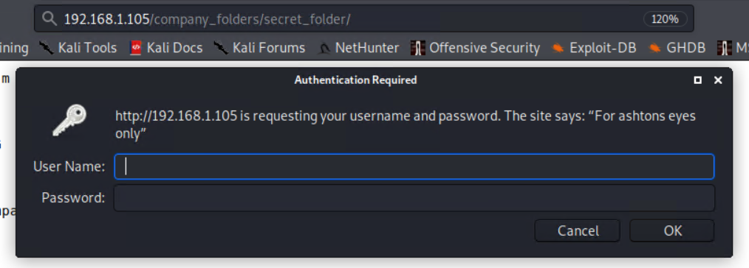
Web Server: No Obfuscation
The red-team were able to find the folder due to minimal obfuscation. An assumption was made to use “ashton” as the user account for our brute-force attempt - “For ashtons eyes only”.

Slide 11
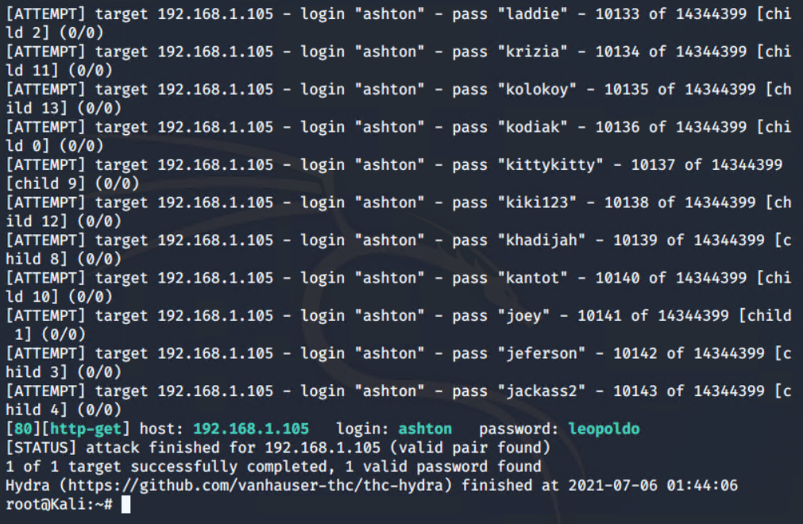
Hydra: Brute-Force Results

Slide 12
Exploitation: Data exposure in web interface
01
02
03
Tools & Processes
The red-team discovered an MD5 hash within the secret_folder for a file-sharing webdav. We used open source tools (crackstation) to easily crack the password to the webdav server.
Achievements
The MD5 hash was cracked - ryan:linux4u.
Please see next slide for screenshots

Slide 13
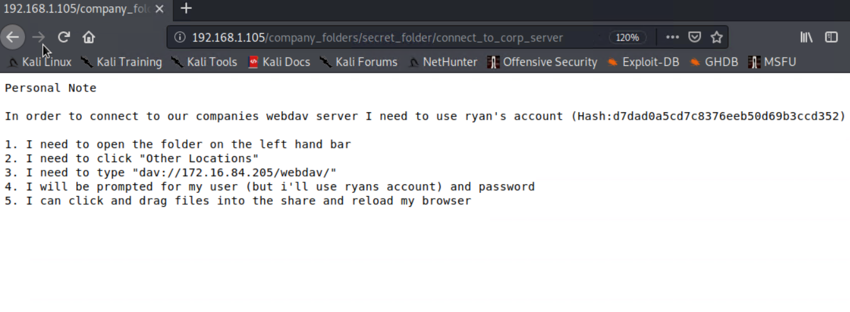
Web Server: Hash discovery

Slide 14
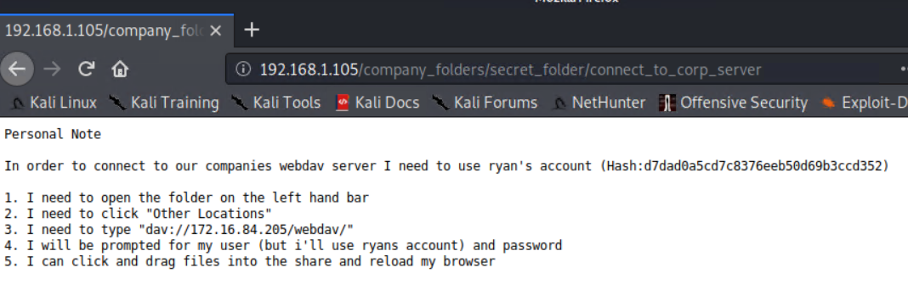
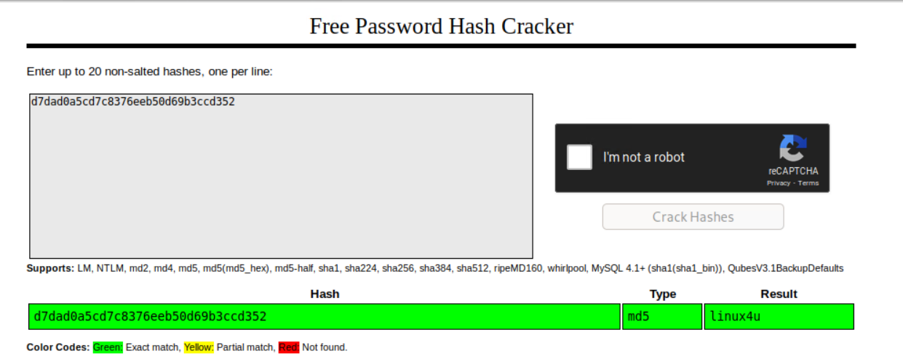
Crack Station: Hashcracking
The red-team were able to decipher the hash that was available on the web server. This should not be internet facing.

Slide 15
Exploitation: Poor security restrictions and controls
01
02
03
Tools & Processes
The red-team used metasploit to initiate a reverse shell connection. A listener was configured on port 4444 so that a reverse php shell could be executed from the webdav directory. There were no restrictions so the red-team was able to upload any file to the directory.
Achievements
The red-team was able to gain root access to the capstone machine and used a series of commands to discover the hidden flag.
Please see next slide for screenshots

Slide 16
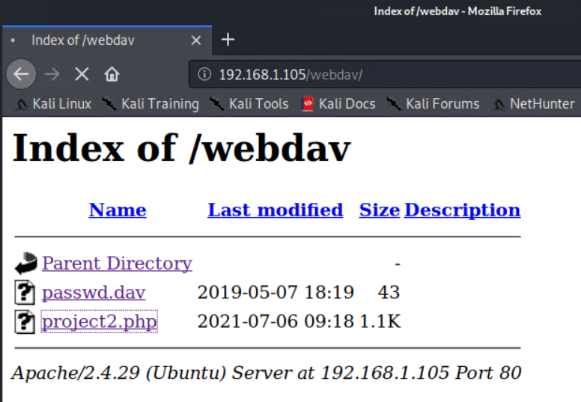
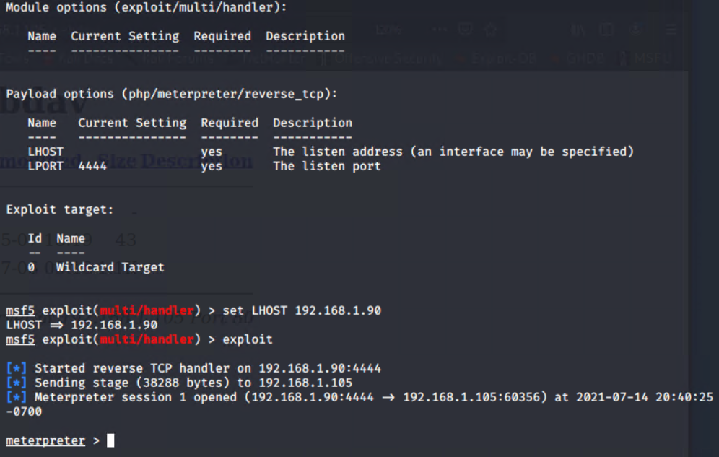
Metasploit: Msfvenom and reverse shell
The red-team executed the php script from the web interface and was able to achieve the reverse shell connection.

Slide 17
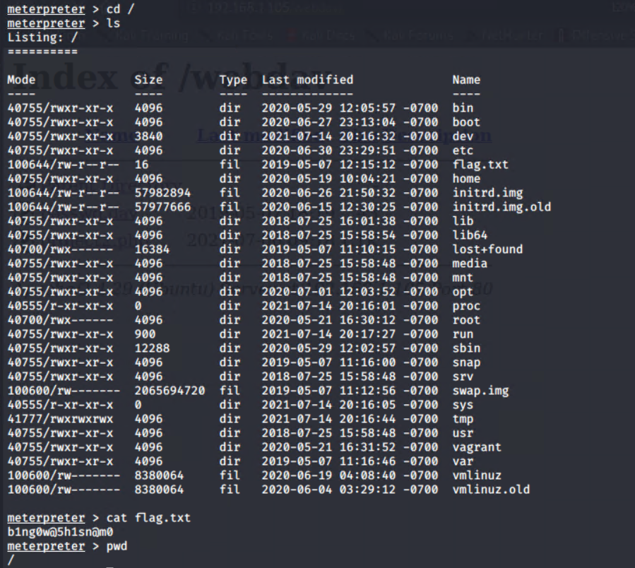
Metasploit: Finding the Flag
The red-team gained root access to find the flag almost instantly.
Ls : List contents of directory
Cat : Reads the contents of a file
Pwd : Displays the current directory
Note: The bottom section indicates a file path of “/”, which proves the red-teams success in to breaking in to webdav.

Slide 18

Blue Team
Log Analysis and Attack Characterization
‹#›

Slide 19
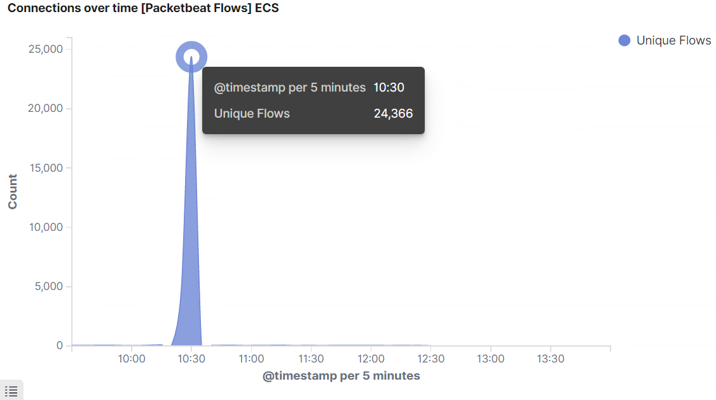
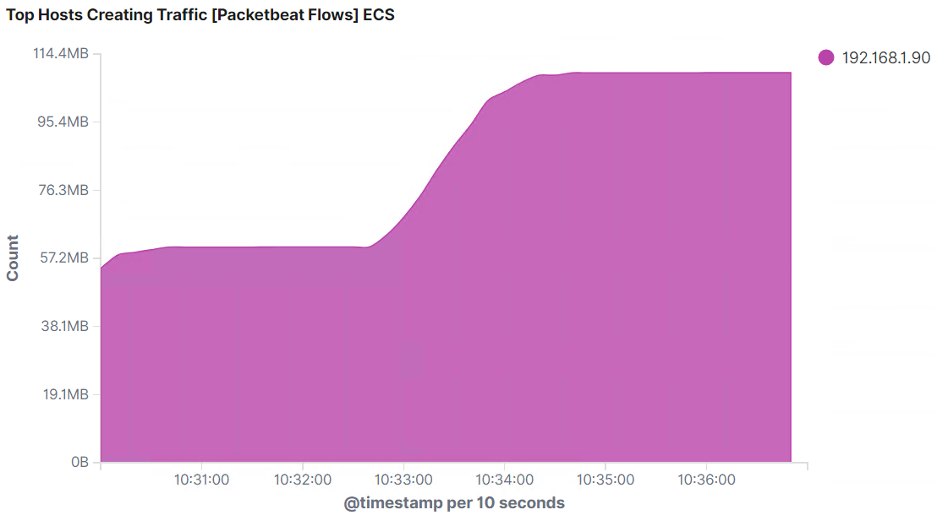
Analysis: Identifying the Port Scan
What time did the port scan occur? 10:30AM
How many packets were sent, and from which IP? We can see that there were 24,366 unique flows detected. Additionally, there’s proof that the traffic was generated by 192.168.1.90 which was used by the red-team
What indicates that this was a port scan? The huge influx in the unique flows indicates that this was a portscan. A portscan will generate large amounts of network traffic with a consistent source IP and a wide range of destination ports. This is because the red-team used nmap to scan for all existing ports within the 192.168.0.1/24 network.

Slide 20
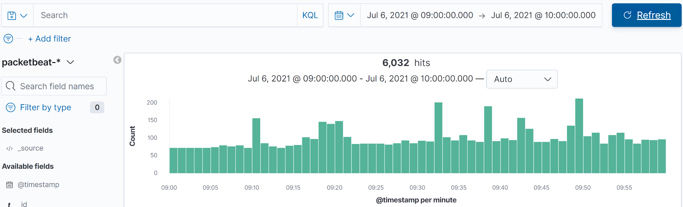
Regular Network Traffic: The baseline
The blue-team was able to develop an understanding of what regular traffic passing through Capstone should look it. This was based on network traffic before the attack occurred. The random spikes could indicate a file download, scheduled backups or a windows update.

Slide 21
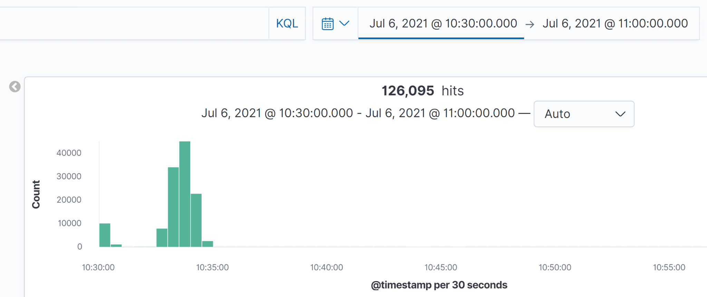
Malicious Network Traffic: Noticeable spikes
The image above represents malicious activity within the network due to a mixture of port scans and brute-force attempts using Hydra.

Slide 22
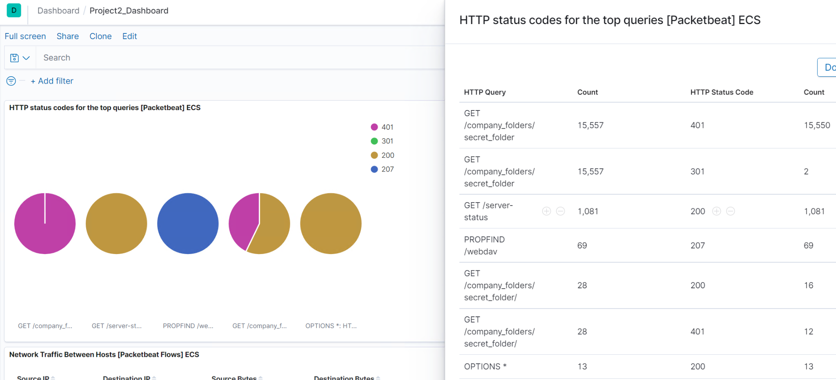
Analysis: Finding the Request for the Hidden Directory
What time did the request occur? How many requests were made? 15,557 requests were made at approximately 10:30AM on July-6th-2021
Which files were requested? What did they contain? The logs indicated that a folder called “connect_to_corp_server” was accessed numerous times. This folder contained a password hash for an account used to access a webdav server.

Slide 23
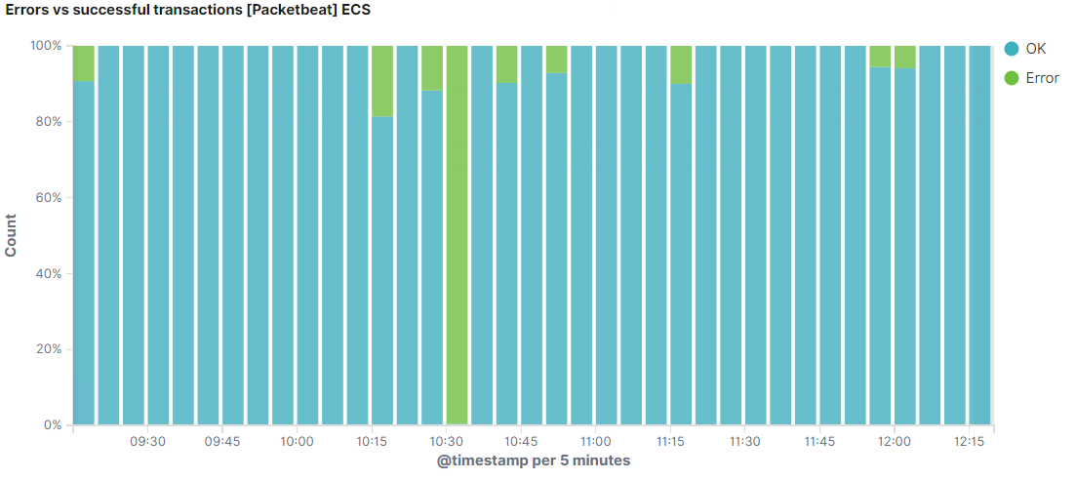
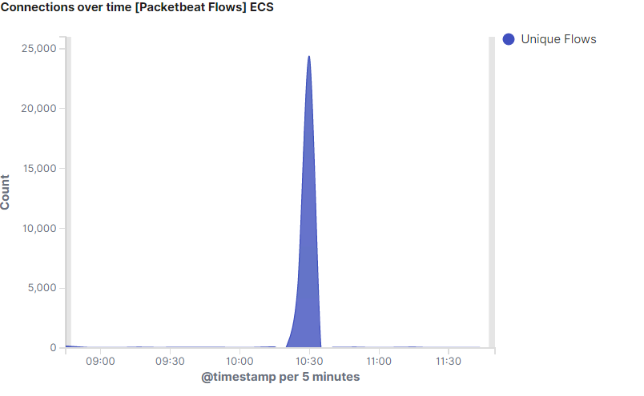
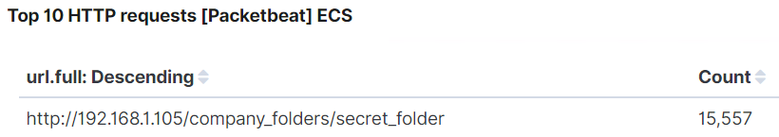
Analysis: Uncovering the Brute Force Attack
How many requests were made in the attack? 15,557
How many requests had been made before the attacker discovered the password? There were over 120,000 requests over the whole network. The total amount of requests made to the directory still remains at 15,557 according to the blue-team’s results.

Slide 24
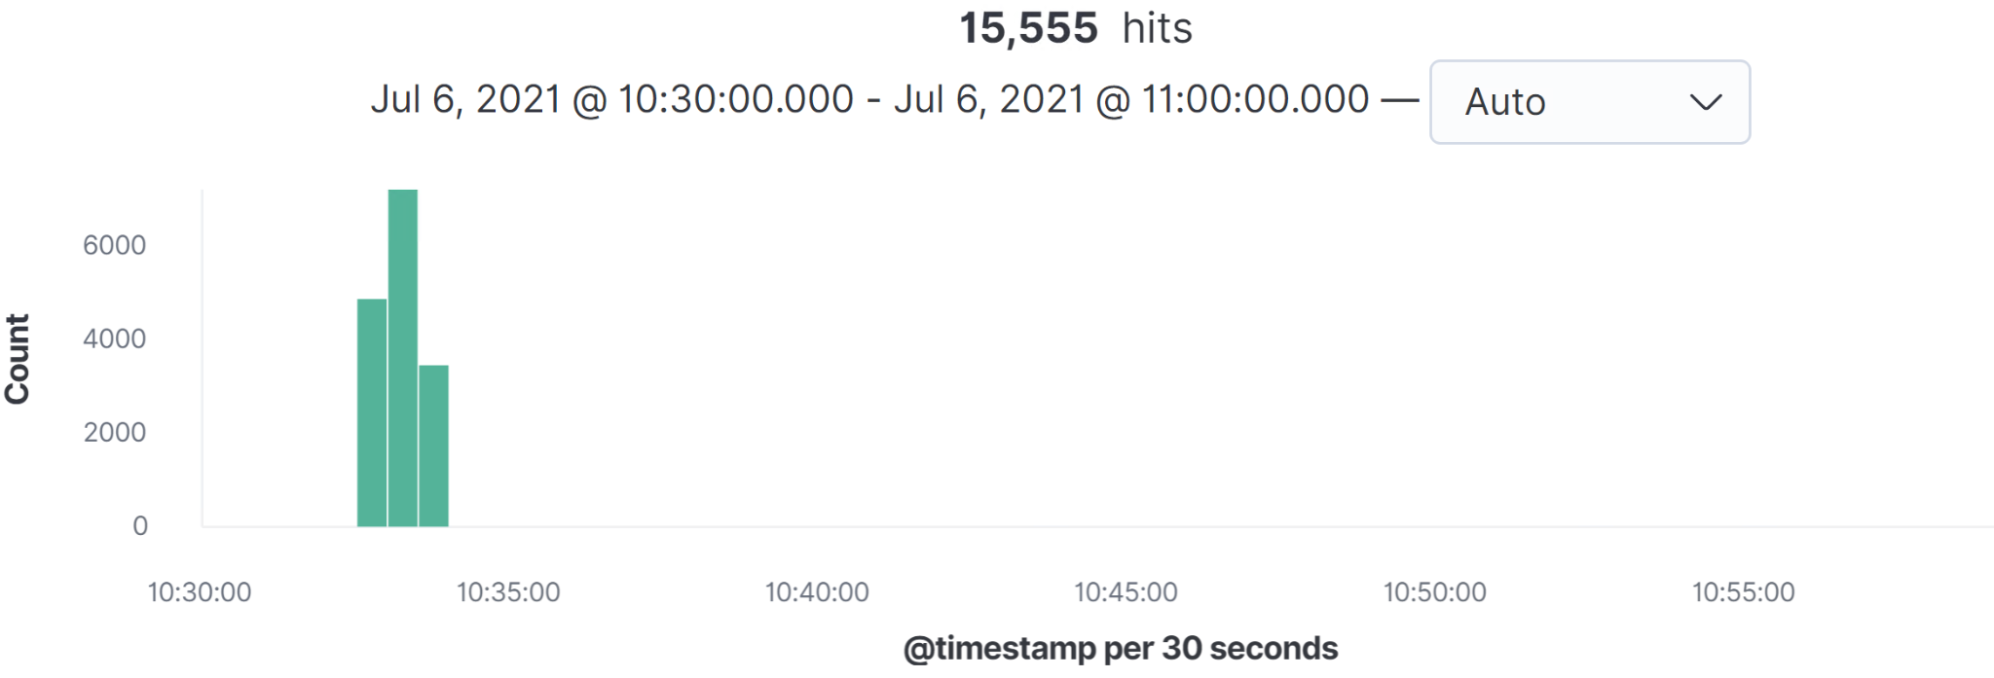
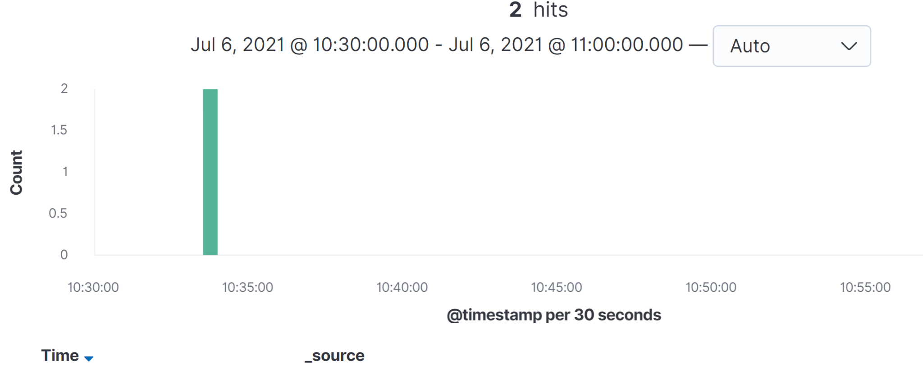
Brute Force: Success vs Failure
Checking Failure Rate
source.ip: 192.168.1.90 and destination.ip: 192.168.1.105 and url.path: "/company_folders/secret_folder" and user_agent.original : "Mozilla/4.0 (Hydra)" and status : "Error"
Checking Success Rate
source.ip: 192.168.1.90 and destination.ip: 192.168.1.105 and url.path: "/company_folders/secret_folder" and user_agent.original : "Mozilla/4.0 (Hydra)" and status : "OK"

Slide 25
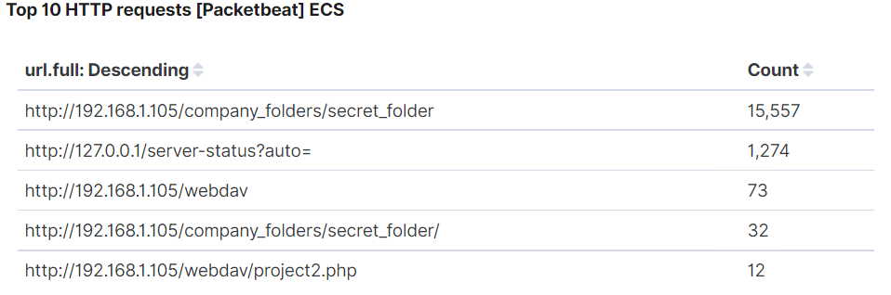
Analysis: Finding the WebDAV Connection
How many requests were made to this directory? 73 times
Which files were requested? Project2.php was requested 12 times

Slide 26
Blue Team
Proposed Alarms and Mitigation Strategies
‹#›

Slide 27
Mitigation: Blocking the Port Scan
What kind of alarm can be set to detect future port scans?
A port scan will create network traffic within layer 3 /4 of the OSI model. For this reason, an alarm should be configured to alert once there’s been excessive TCP/UDP traffic detected from a common IP address or range to a multitude of ports.
What threshold would you set to activate this alarm?
Port scanning is prevalent in today’s society so this is an extremely difficult task. The blue-team recommends to create a threshold for 1024 ports scanned under 10 seconds. This is because most port scans start with the well-known ports.
What configurations can be set on the host to mitigate port scans?
Create Firewall rules to only open ports that are needed. For example, only opening port 80, 443 for HTTP and HTTPS respectively.
Antivirus solutions help deter any suspicious traffic if it suspects a certain IP is probing the network.
Describe the solution. If possible, provide required command lines.
Antivirus solutions such as McAfee provides extensive endpoint monitoring tools that utilize AI to detect trends within the network.

Slide 28
Mitigation: Finding the Request for the Hidden Directory
What kind of alarm can be set to detect future unauthorized access?
An email alert should be created to notify system administrators if an unknown IP address attempts to connect to this directory.
What threshold would you set to activate this alarm?
The threshold for this should be 1 attempt. The operators must be notified immediately if an unknown IP attempts to connects to the hidden directory.
What configuration can be set on the host to block unwanted access?
The best configuration would be to create a firewall rule by blocking the connection from all unknown IP addresses and ports. This IP filter will prevent anyone attempting to gain access from another machine.
Directory paths to the secret_folder should not be available on the public webserver. This must be removed.
Describe the solution. If possible, provide required command lines.
Please see next slide for instructions.

Slide 29
Linux Firewall: Uncomplicated Firewall (UFW) with port 443
The blue-team recommends UFW to block all traffic, and then allow specific IP’s and ports to connect to the directory
sudo apt install ufw
This will install UFW on to the machine.
sudo ufw default deny incoming
Block all incoming connections.
sudo ufw default allow outgoing
Allows all outgoing connections.
sudo ufw allow 443
The blue-team recommends port 443 (HTTPS) To ensure traffic is encrypted.
sudo ufw allow [IP of machine(s)]
Allow certain IP(s) to have access to the directory
sudo ufw deny
Closes specific ports. The red-team recommends Denying 80(HTTP).
sudo ufw enable
Starts the firewall and update rules.
sudo ufw reload
Reloads the UFW firewall.

Slide 30
Mitigation: Preventing Brute Force Attacks
What kind of alarm can be set to detect future brute force attacks?
We could create a rule to notify operators if the HTTP response code 401 is received more than X amount of times in a Y time period. It’s also imperative to include a rule that flags the use of a user.agent with “Hydra” in it. The same logic can be applied to other well known password cracking tools.
What threshold would you set to activate this alarm?
The blue-team believes the threshold should be 5 times within 1 minute.
What configuration can be set on the host to block brute force attacks?
Once the limit of 5 for the 401 unauthorized code has been reached, a configuration can be made to block that machine’s IP so that it can’t reconnect for 30 minutes.
Two-Factor Authentication will also provide an extra layer of security and will prevent any automated tools from performing these attacks. Recaptcha methods are also effective.
Describe the solution. If possible, provide the required command line(s).
Please see next slide

Slide 31
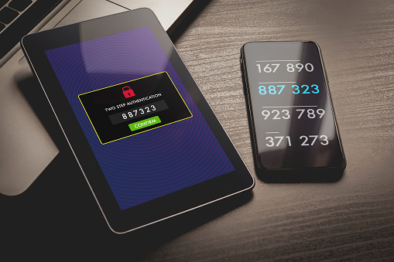

Brute-Force: Prevention
Two-Factor-Authentication (2FA) and Captcha methods are the most effective when it comes to preventing these attacks.
Ensure the company servers employ 2FA and use an authenticator such as Google Authenticator to add extra security
Adding recaptcha challenges to web servers is another recommended method to prevent any autonomous brute-force attempts. It will attempt to distinguish between a bot and a human.
Image Source : https://pixabay.com/images/search/2fa/

Slide 32
Mitigation: Detecting the WebDAV Connection
What kind of alarm can be set to detect future access to this directory?
An email alert should be created to notify system administrators if an unknown IP address accesses the directory.
What threshold would you set to activate this alarm?
The threshold for this should be 1 attempt. The operators must be notified immediately if an unknown IP attempts to connects to the WebDAV directory.
What configuration can be set on the host to control access?
The most effective method would be to create a firewall rule using UFW to restrict access to the directory.
Describe the solution. If possible, provide the required command line(s). The blue-team recommends using UFW or FirewallD to configure these rules. Please refer to
Slide 25: Linux Firewall: UFW with port 443

Slide 33
Mitigation: Identifying Reverse Shell Uploads
What kind of alarm can be set to detect future file uploads?
An alarm can be configured to notify the operator that traffic was detected travelling through port 4444. 4444 is the default port for meterpreter which is often left unchanged by threat actors.
What threshold would you set to activate this alarm?
The threshold for this should be 1 attempt. The operators must be notified immediately if there is traffic going through 4444.
What configuration can be set on the host to block file uploads?
The blue-team recommends to implement security restrictions to only allow certain file formats to be uploaded.
Additionally, file uploads should be outside of the webserver’s public directory. This will prevent attackers running malicious scripts as a root user.
Describe the solution. If possible, provide the required command line.
This will create an application whitelist which will also block them from running. Antivirus and endpoint monitoring tools can also be used to scan the files contents to prevent the upload of malicious files.

